Slide 1


E-retail factors for customer activation and retention
Data Analysis, Visulisation and Creating ML model

Slide 2
Abstract
Customer satisfaction has emerged as one of the most important factors that guarantee the success of online store; it has been posited as a key stimulant of purchase, repurchase intentions and customer loyalty. A comprehensive review of the literature, theories and models have been carried out to propose the models for customer activation and customer retention. Five major factors that contributed to the success of an e-commerce store have been identified as: service quality, system quality, information quality, trust and net benefit. The research furthermore investigated the factors that influence the online customers repeat purchase intention. The combination of both utilitarian value and hedonistic values are needed to affect the repeat purchase intention (loyalty) positively. The data is collected from the Indian online shoppers. Results indicate the e-retail success factors, which are very much critical for customer satisfaction.

Slide 3
Project Ouline/Stages
Exploratory Data analysis.
03
Data Visualisation
04
Machine learning model
06
Conclusion
07
Importing libraries and dependencies
01
Loading/Importing Data
02
Data Preprocessing
05

Slide 4
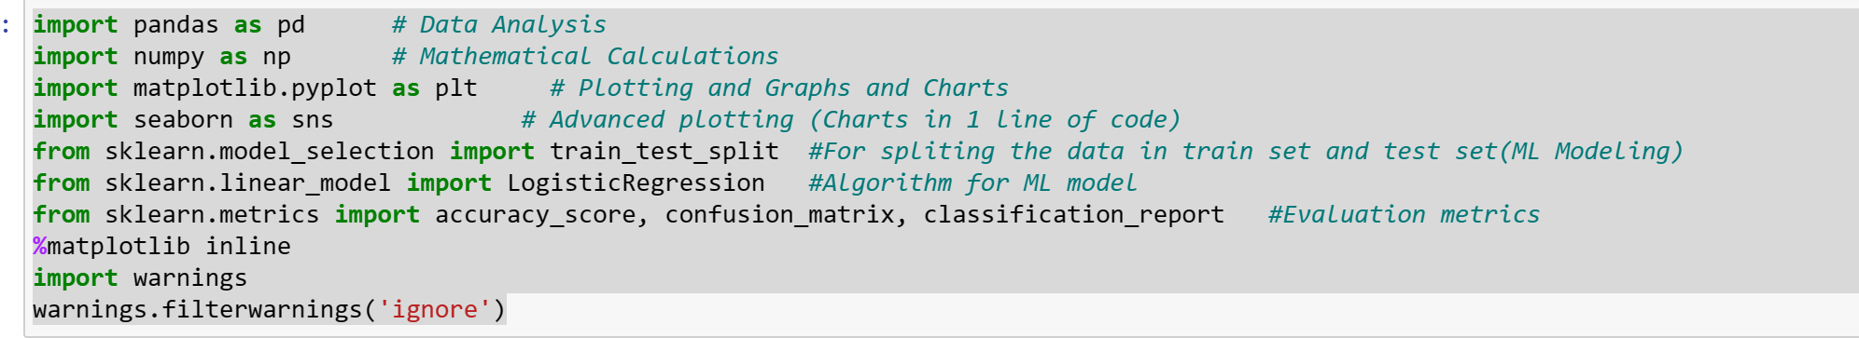
Importing Dependencies
import pandas as pd # Data Analysis
import numpy as np # Mathematical Calculations
import matplotlib.pyplot as plt # Plotting and Graphs and Charts
import seaborn as sns # Advanced plotting (Charts in 1 line of code)
from sklearn.model_selection import train_test_split #For spliting the data in train set and test set(ML Modeling)
from sklearn.linear_model import LogisticRegression #Algorithm for ML model
from sklearn.metrics import accuracy_score, confusion_matrix, classification_report #Evaluation metrics
%matplotlib inline
import warnings
warnings.filterwarnings('ignore’)

Slide 5
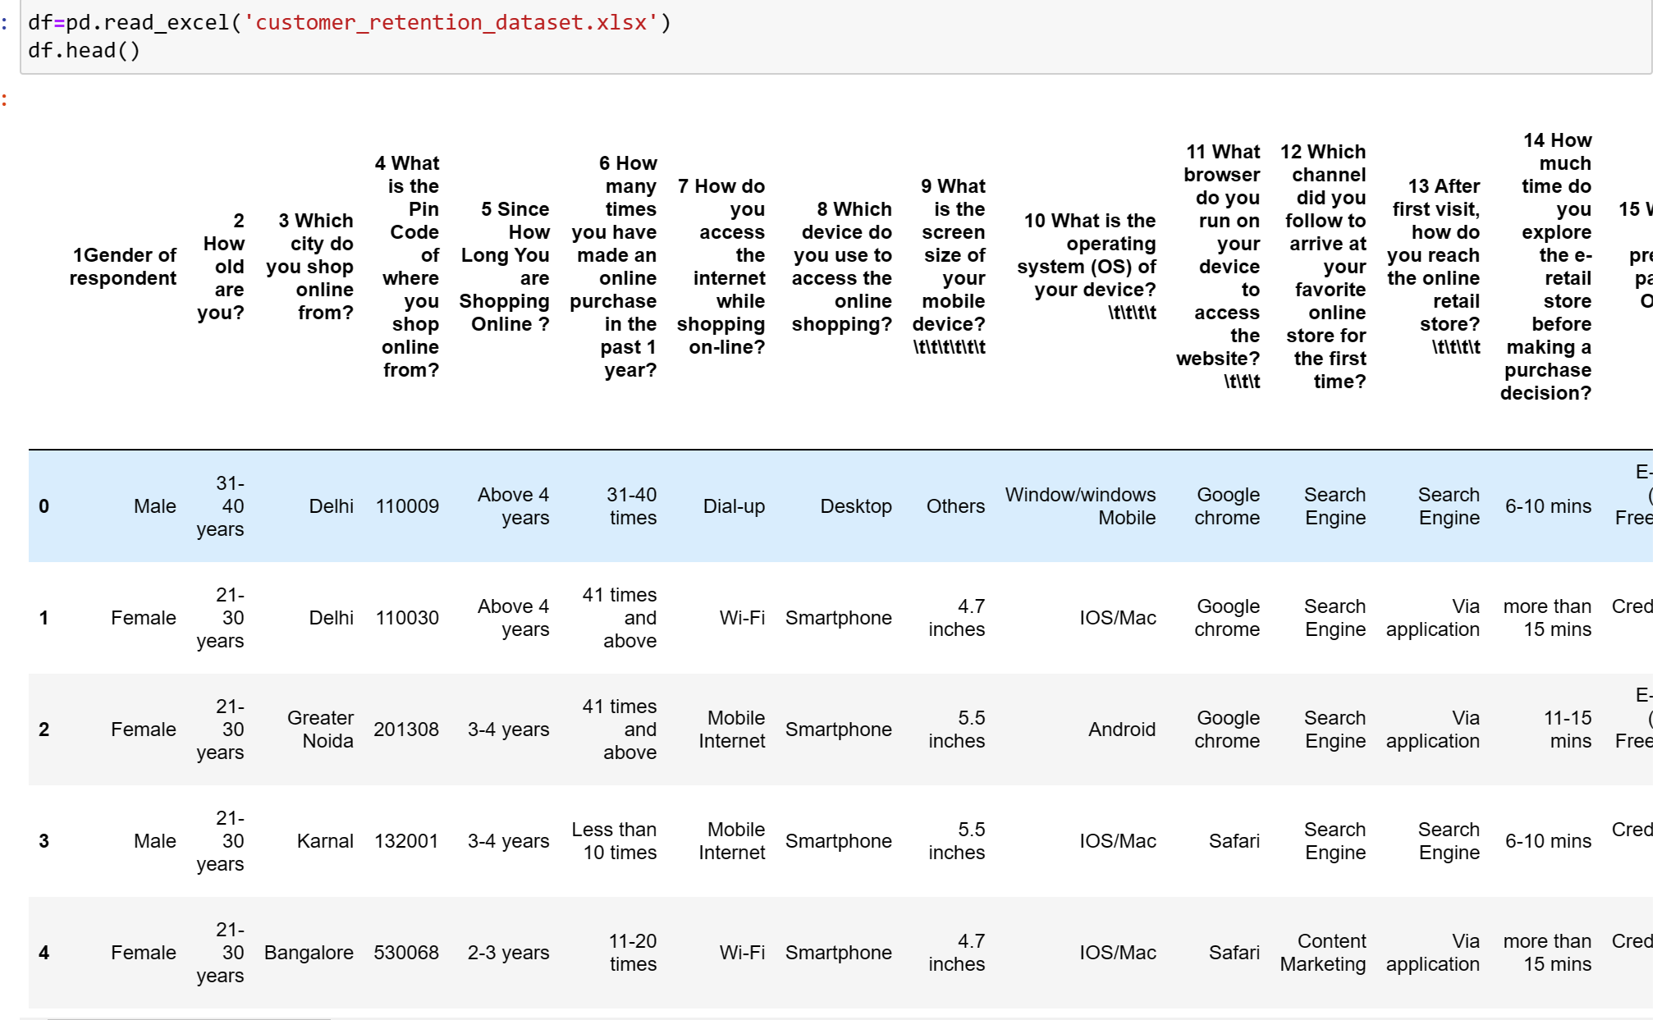
Loading Data

Slide 6
Exploratory Data Analysis
Data Information
Data Cleaning
Data Segmentation

Slide 7
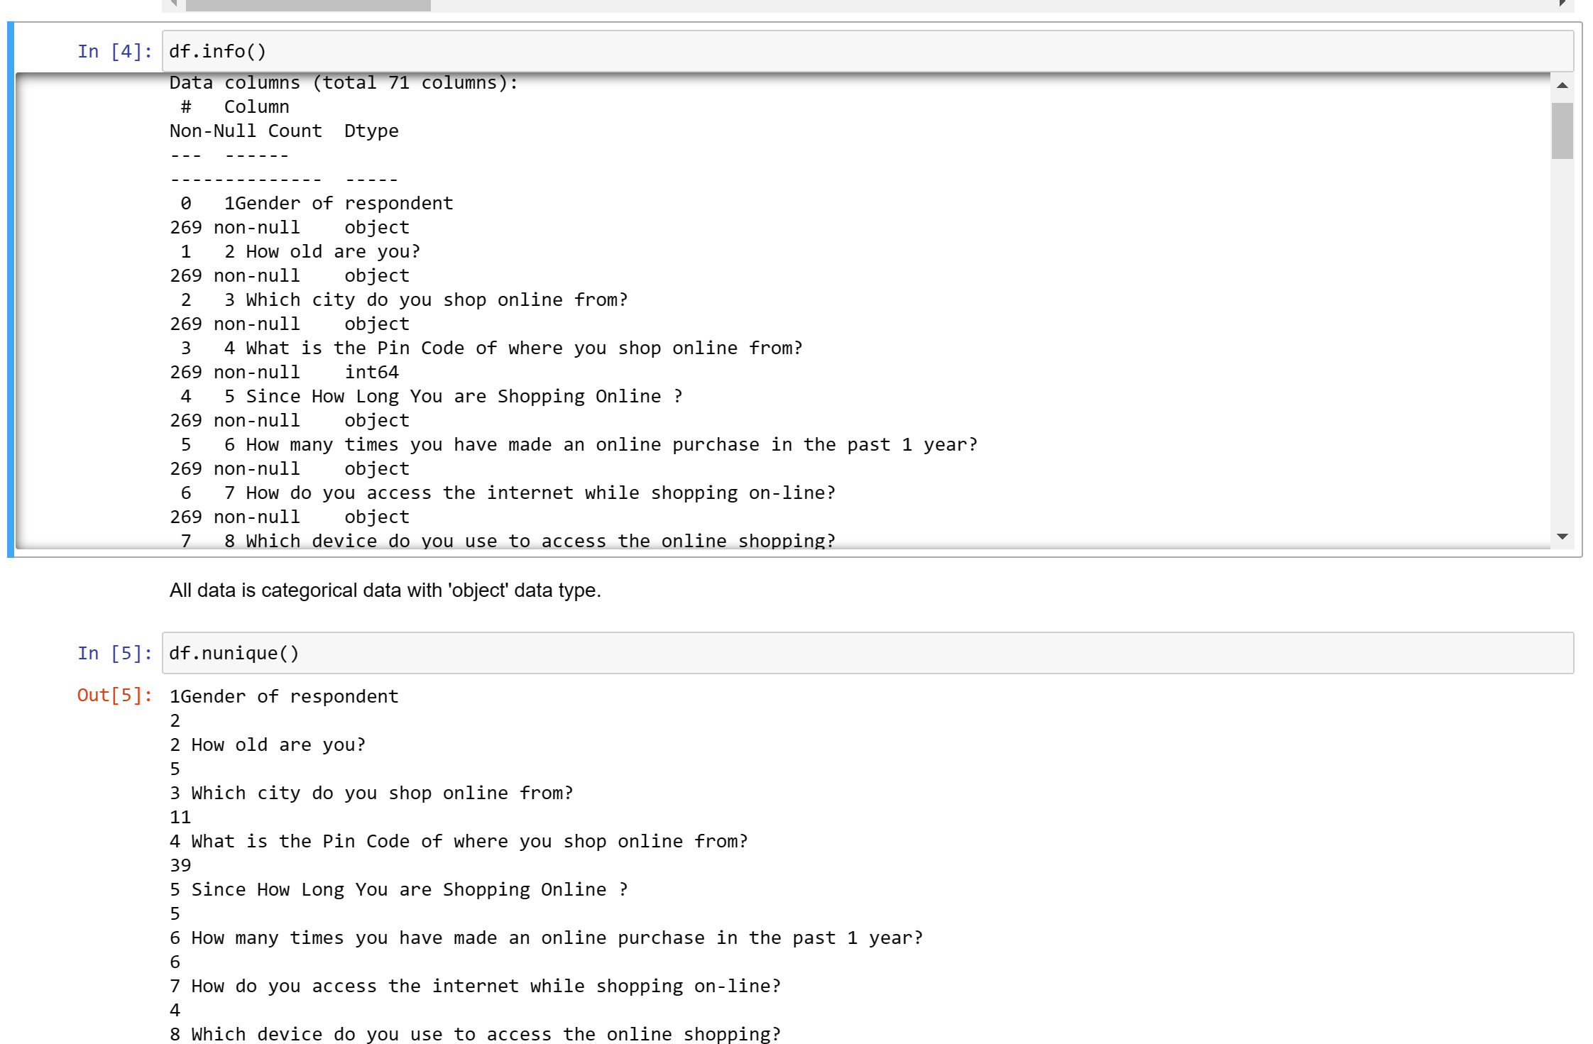
Data Information

Slide 8
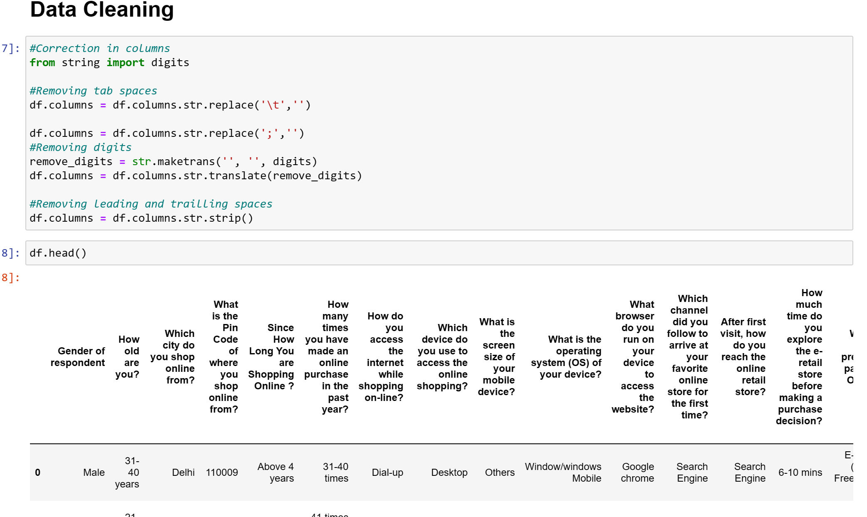
Data Cleaning

Slide 9
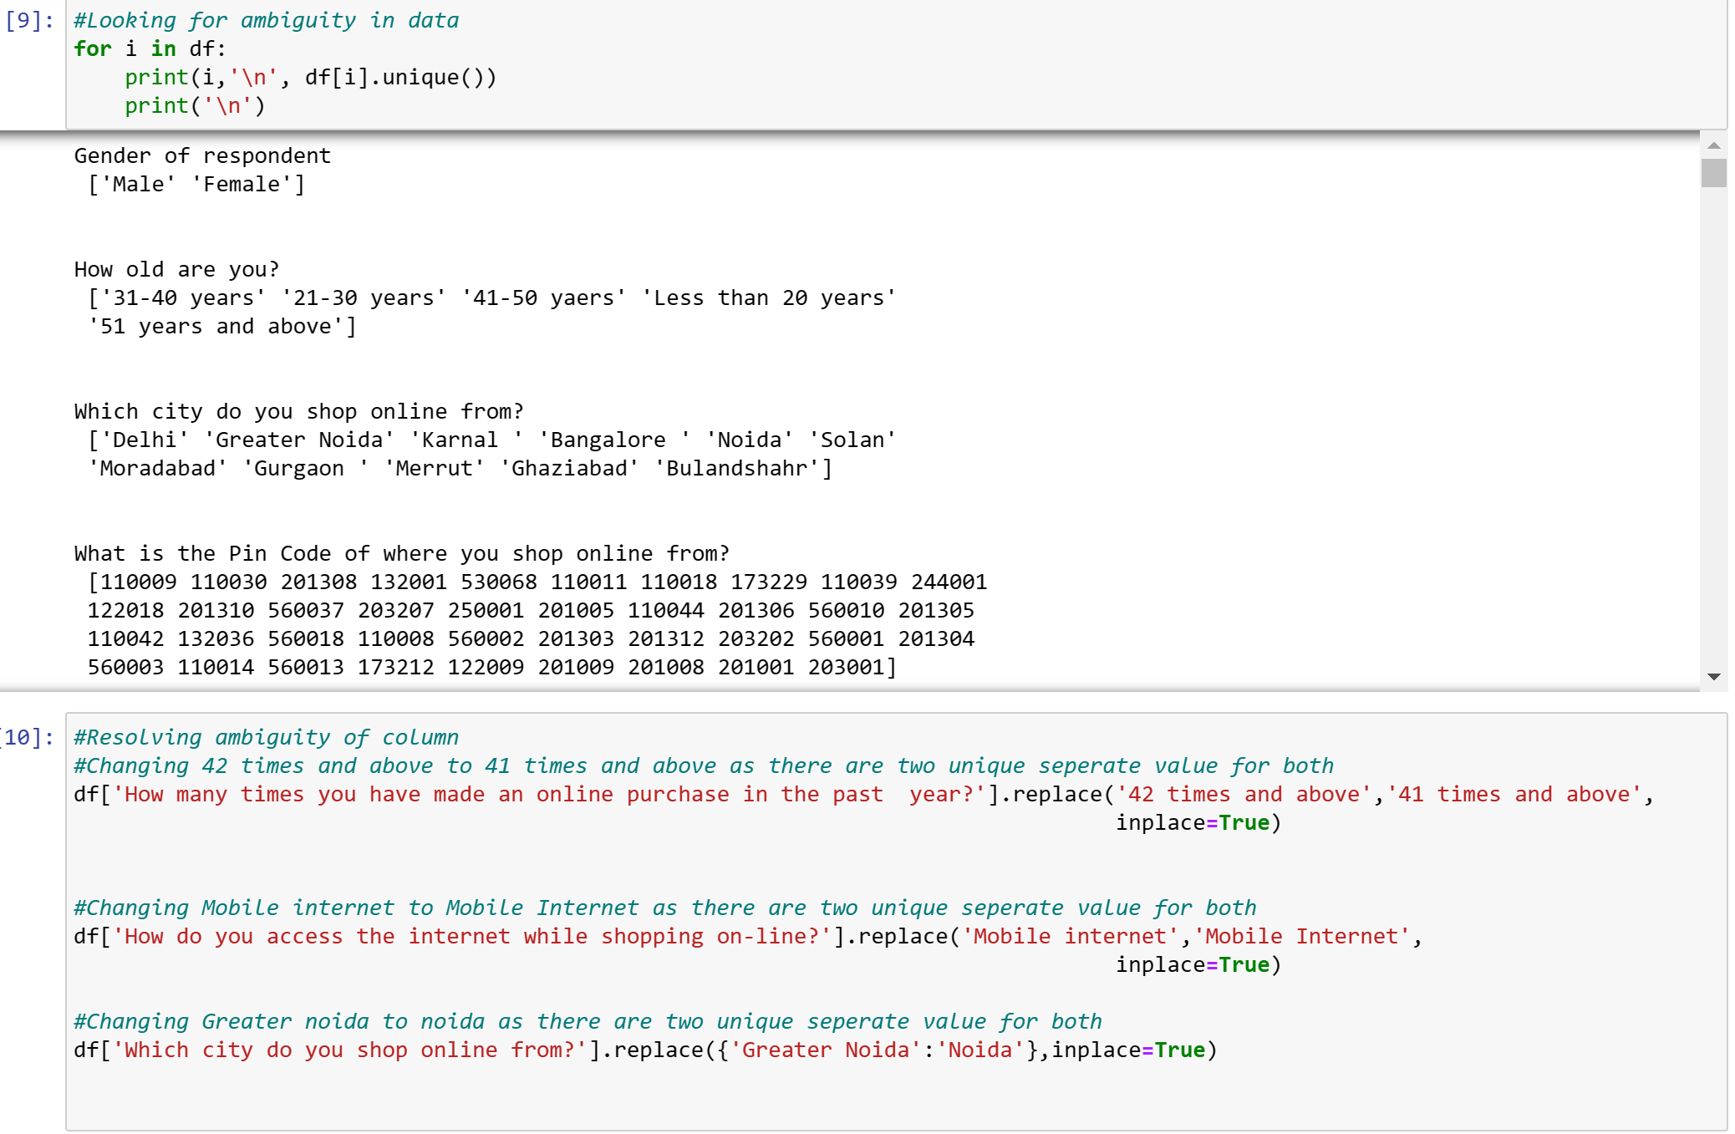

Slide 10
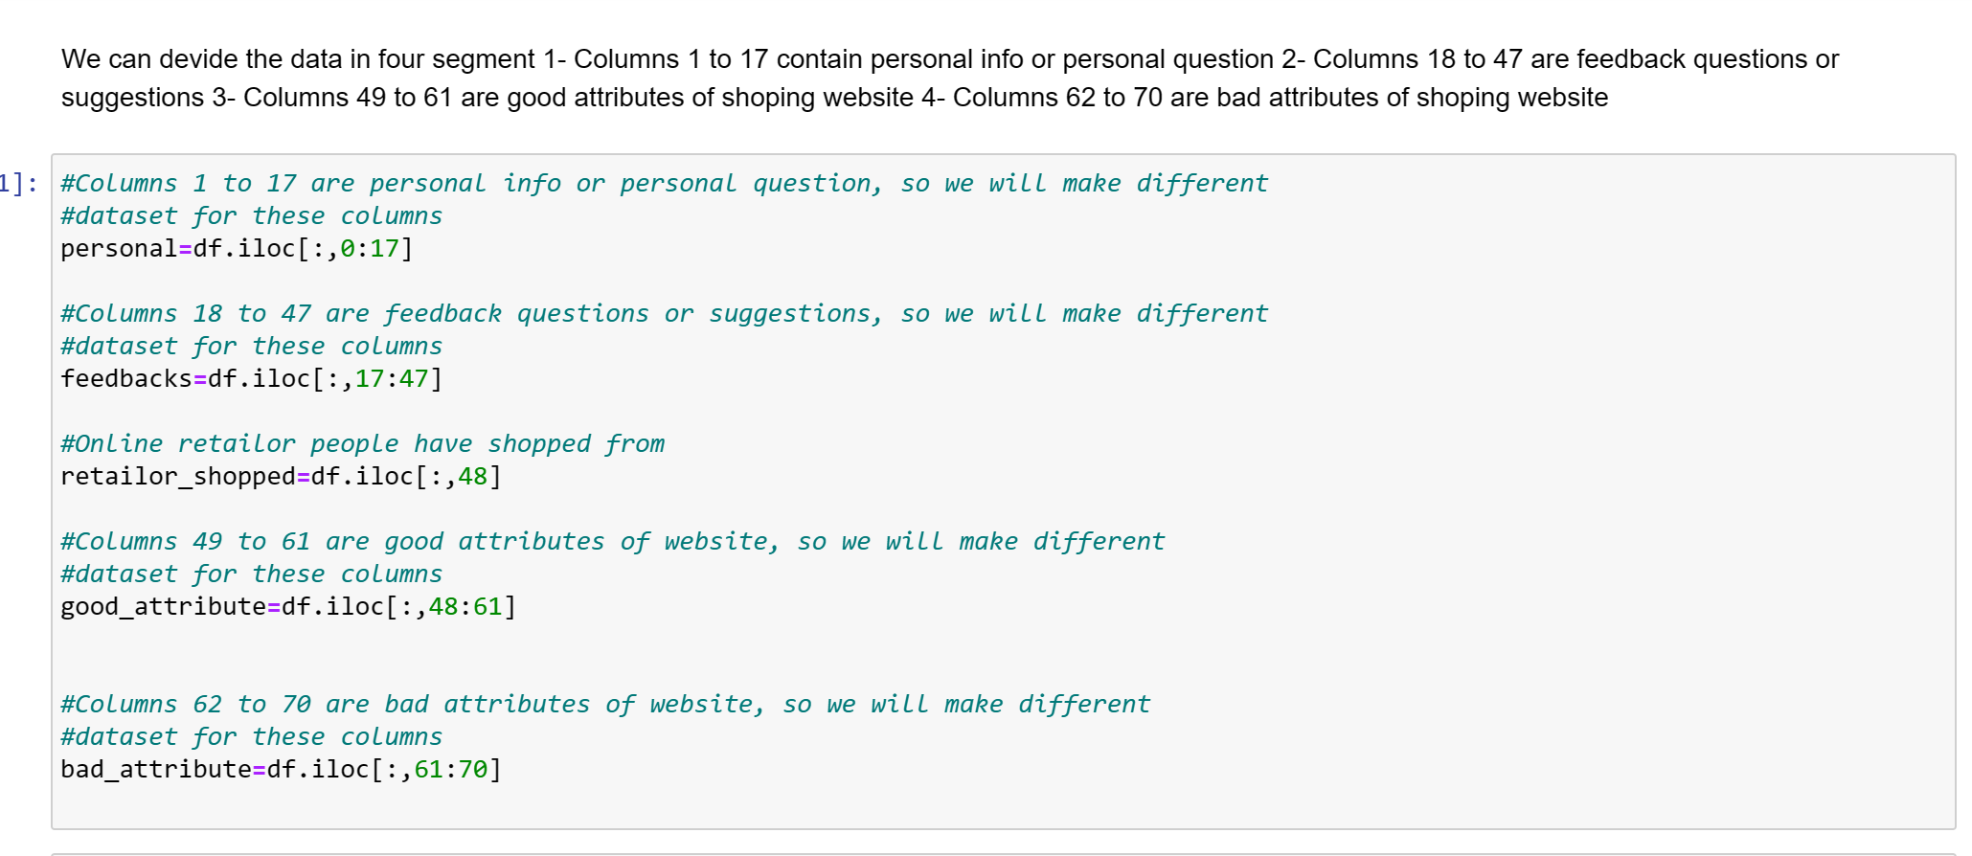
Data Segmentation

Slide 11
Visualisation
Univariate Analysis: For each data segment
Bi-variate Analysis

Slide 12
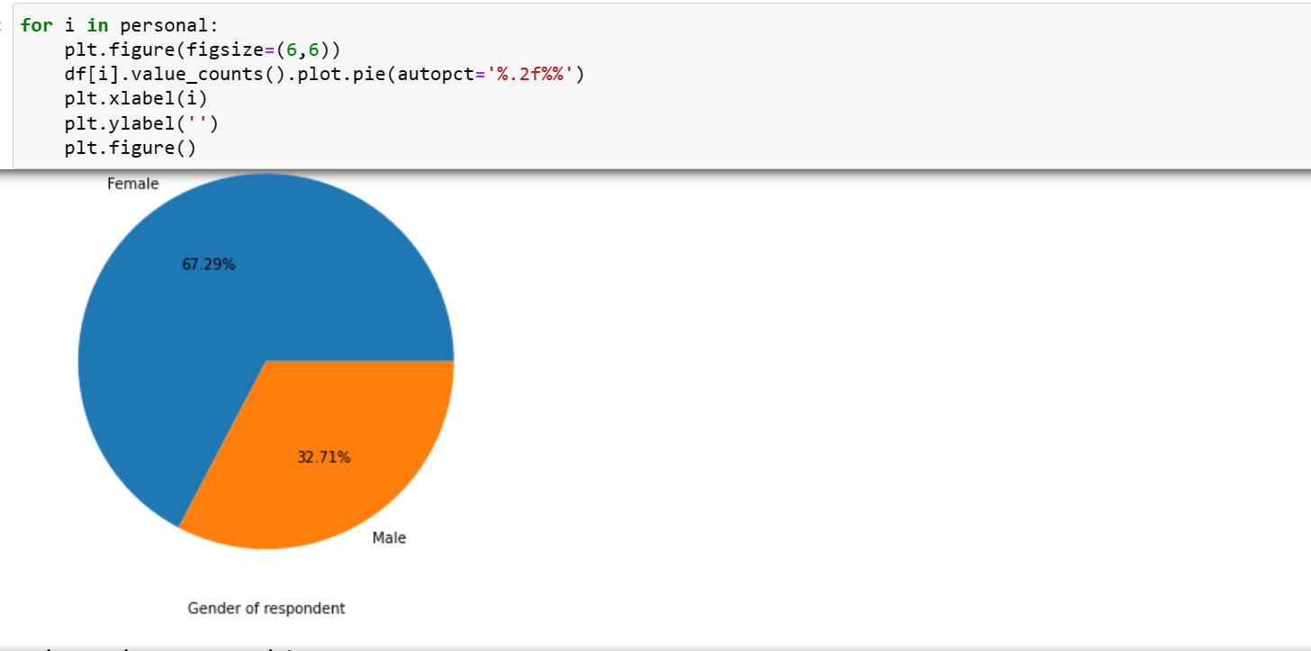
Univariate Analysis

Slide 13
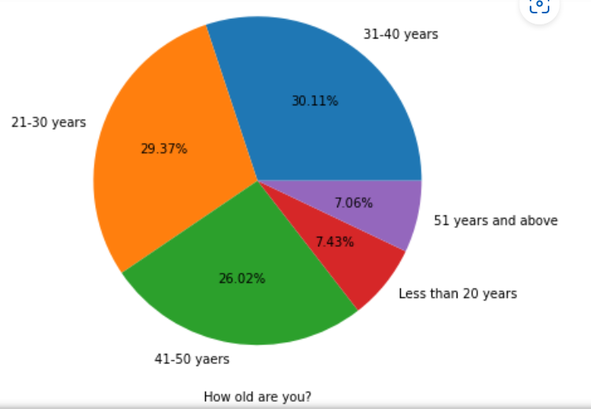
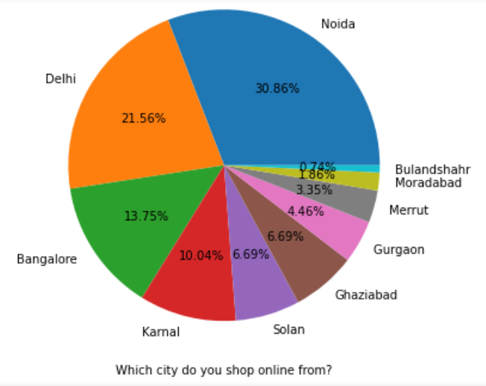
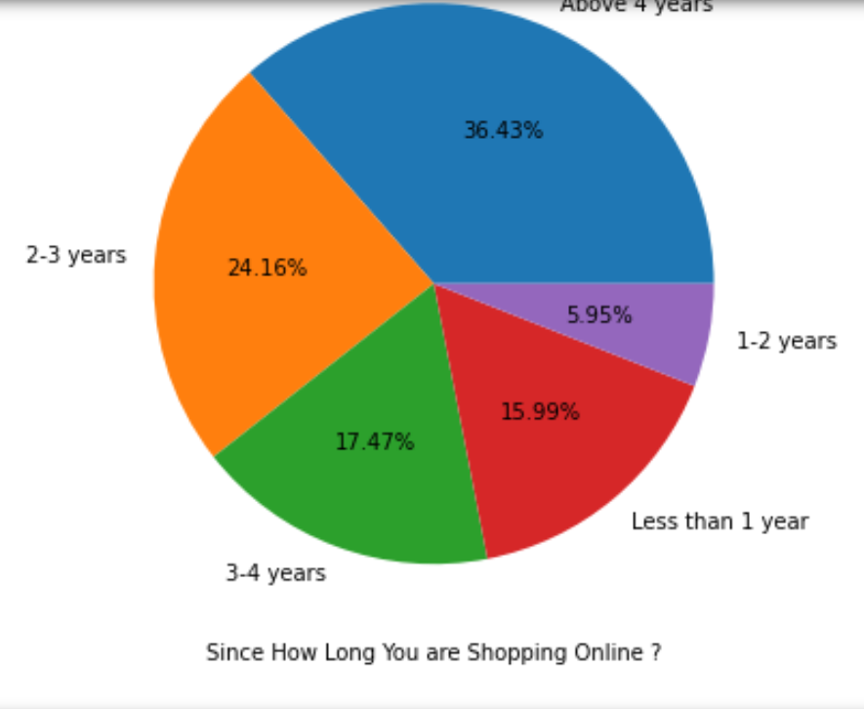
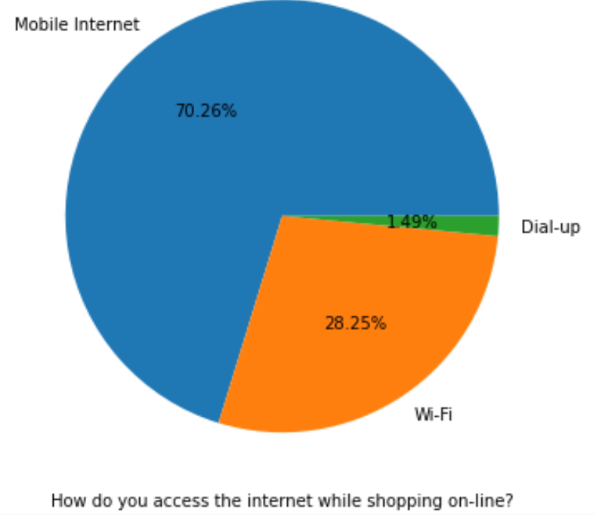
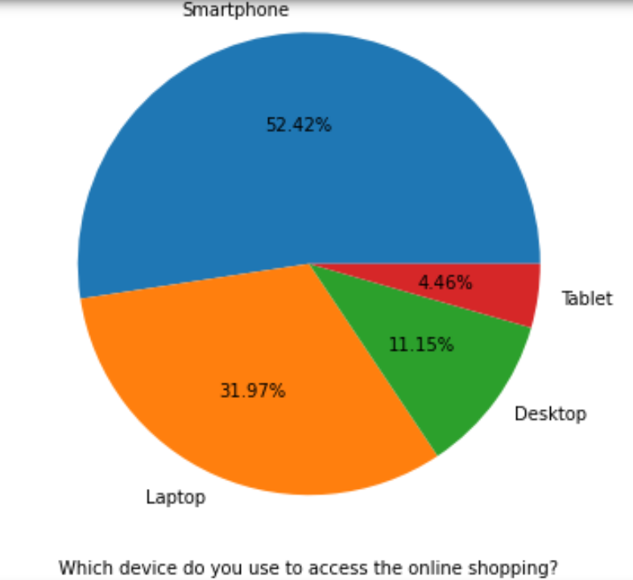
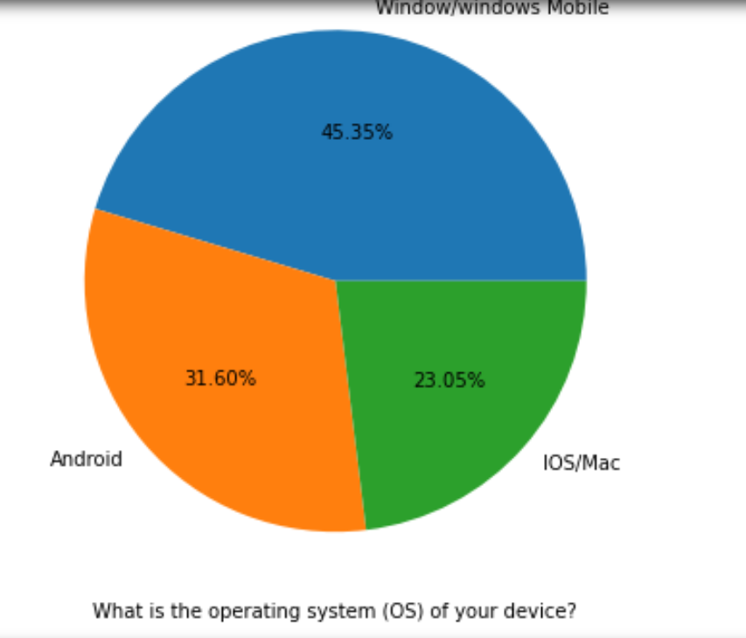

Slide 14
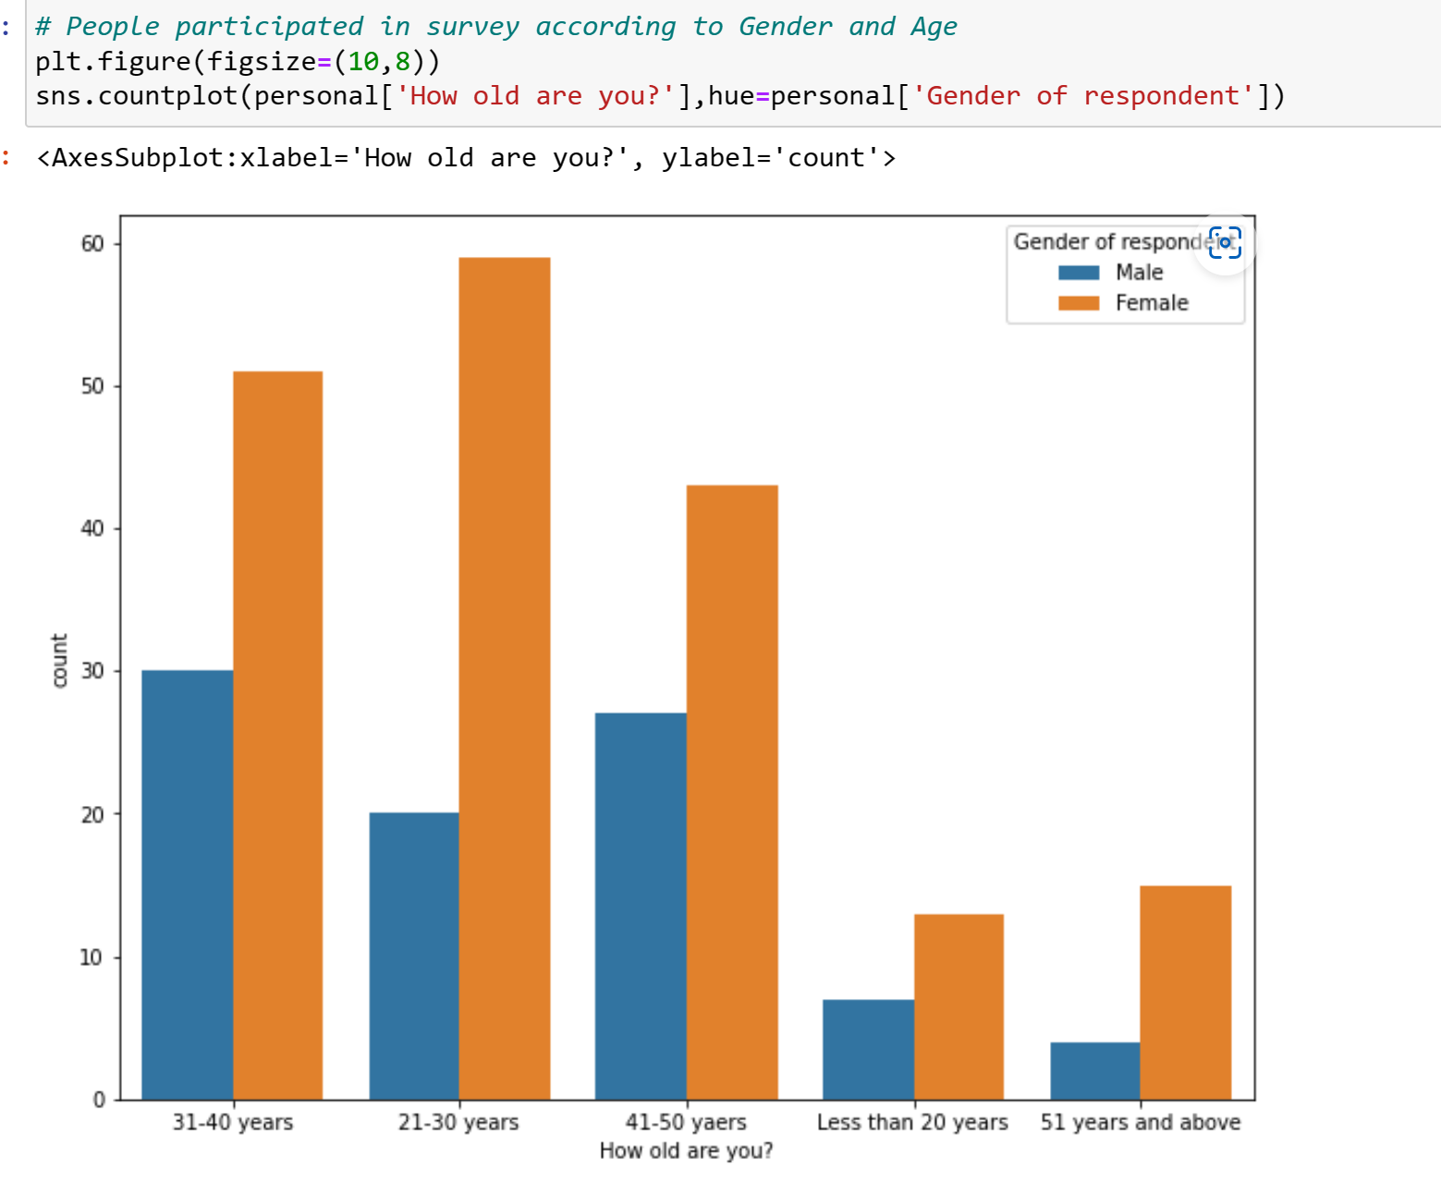
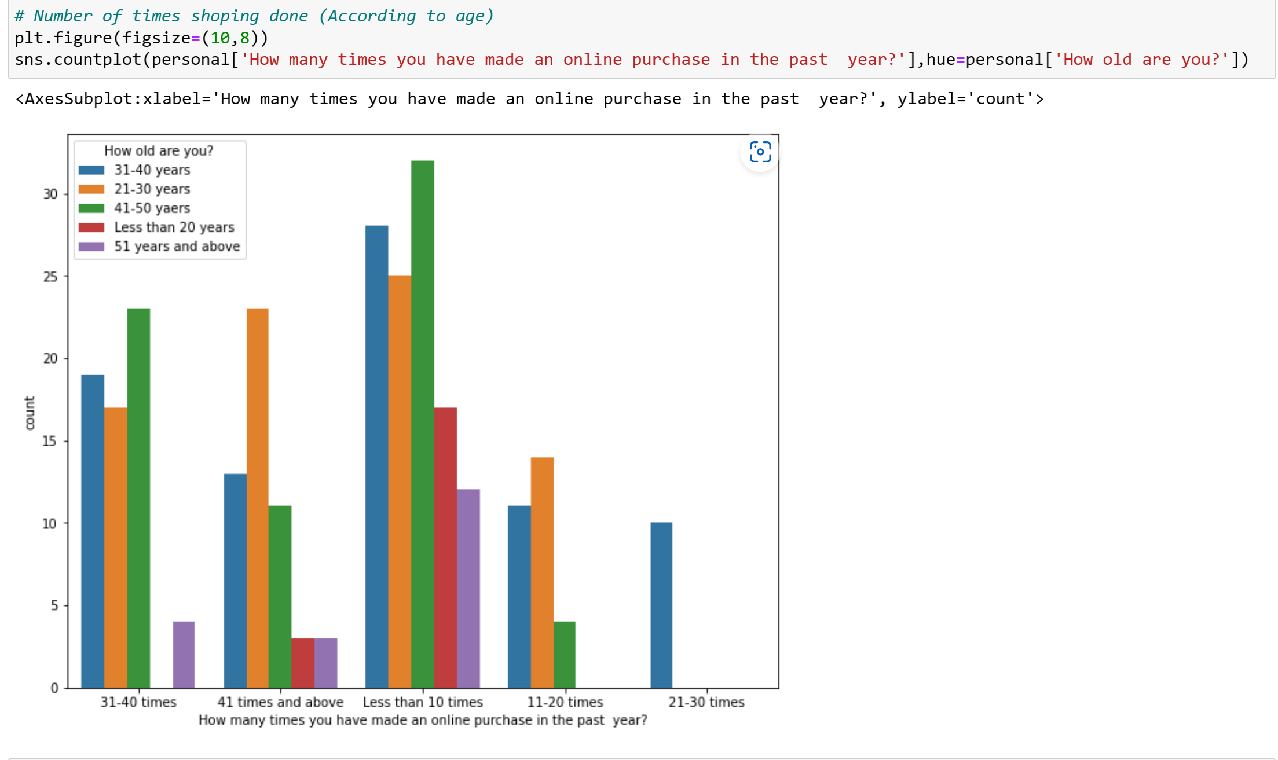
Bi-variate Analysis

Slide 15
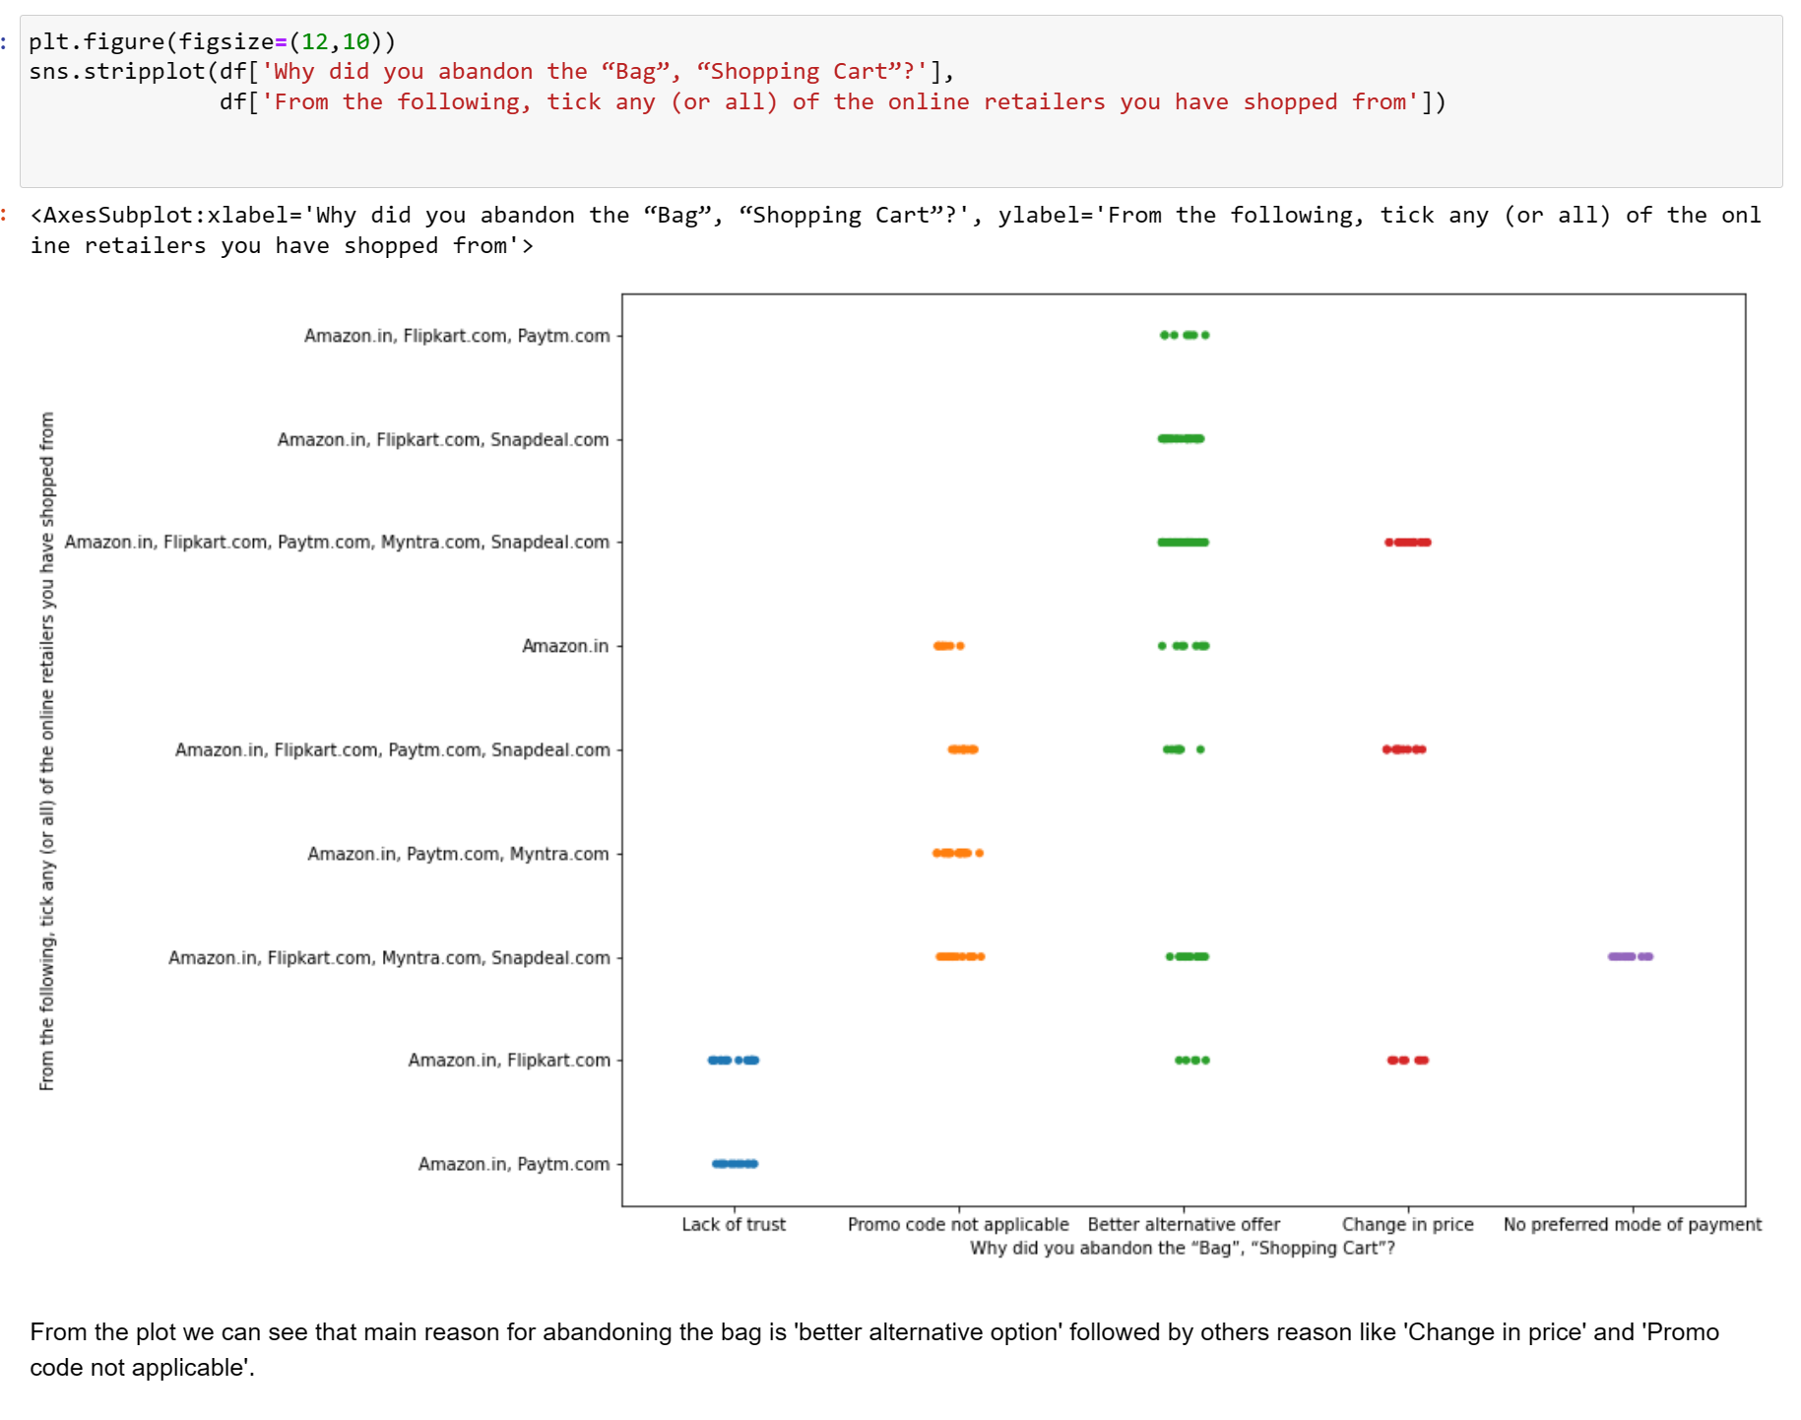

Slide 16
Data Preprocessing
Deviding Data into feature(x) and target(y)
Encoding Categorical Columns
Scaling

Slide 17
Deviding Data into feature/target
x=df.drop('Which of the Indian online retailer would you recommend to a friend?',axis=1)
y=df['Which of the Indian online retailer would you recommend to a friend?']

Slide 18
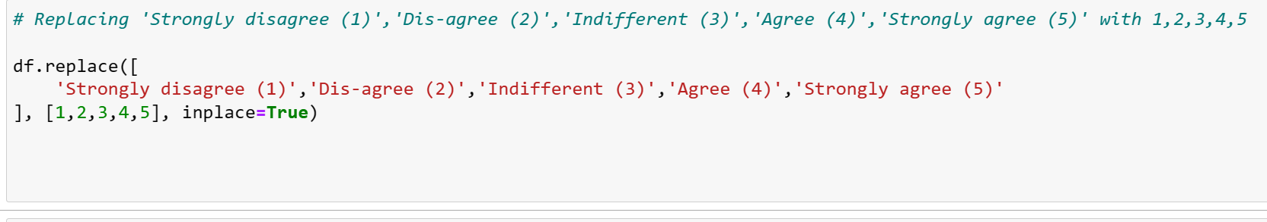
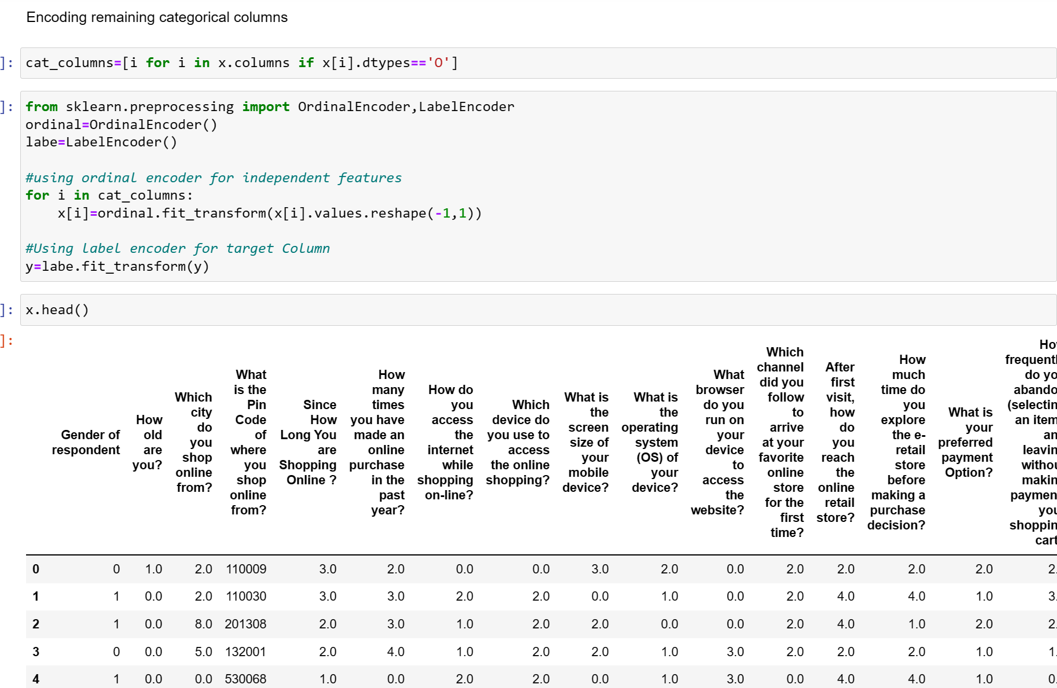
Encoding The Categorical Columns

Slide 19
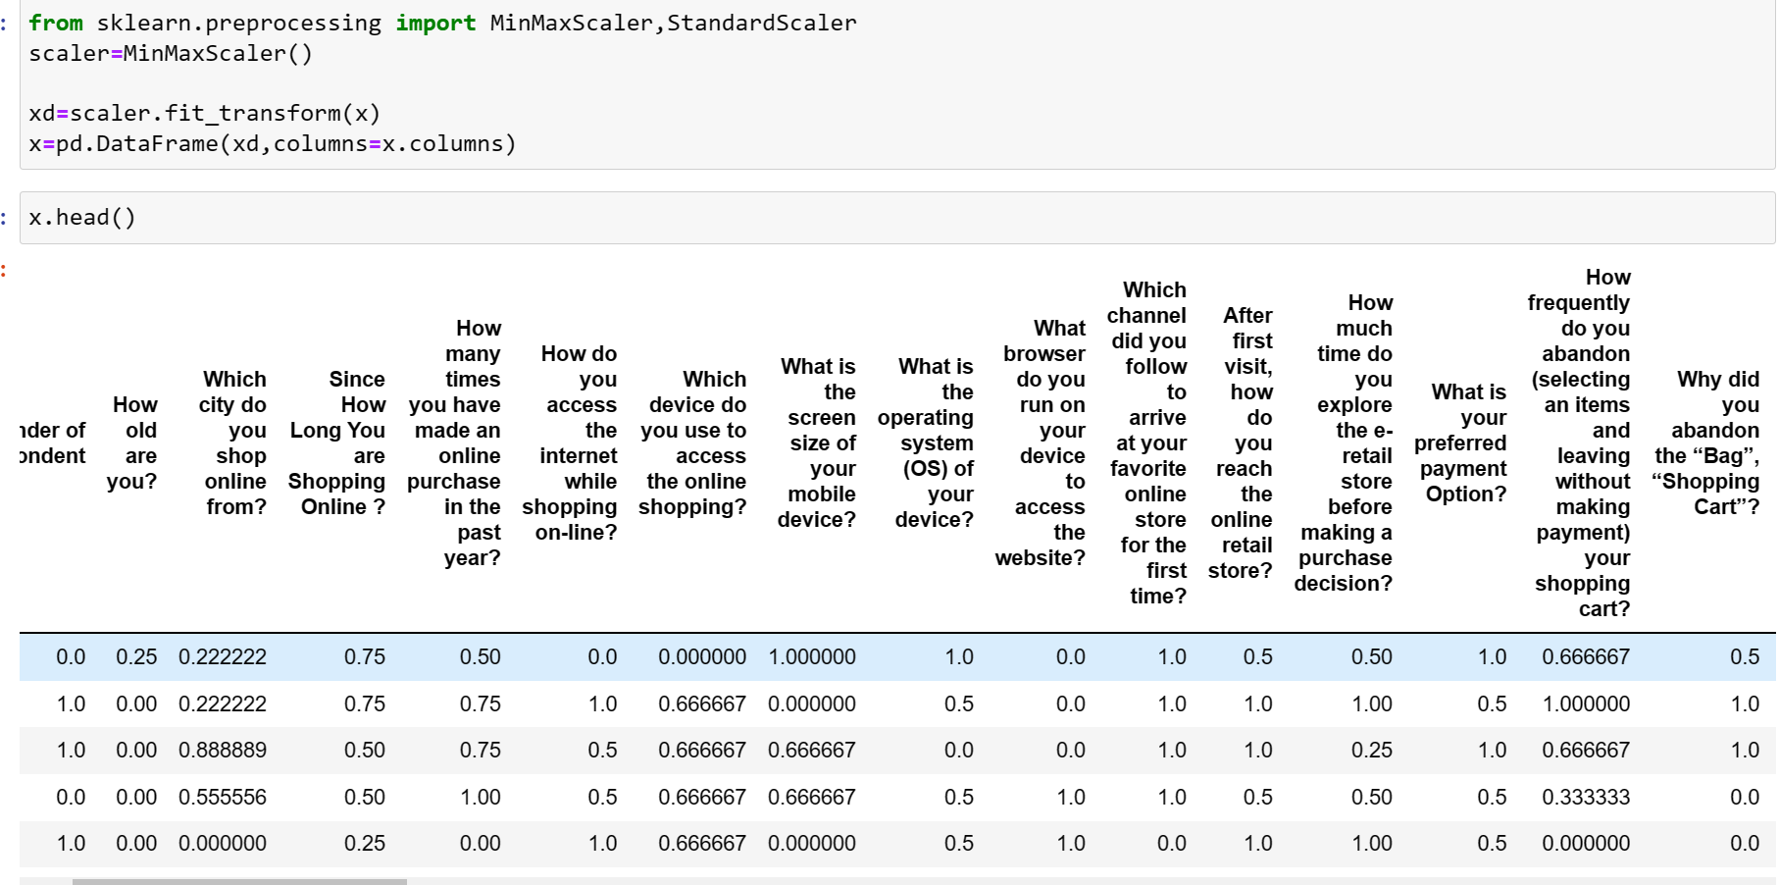
Scaling

Slide 20
Creating ML Model
Train Test split
Model Fitting
Cross Validation
Ensemble Techniques
Hyperparameter Tuning
Saving final Model

Slide 21
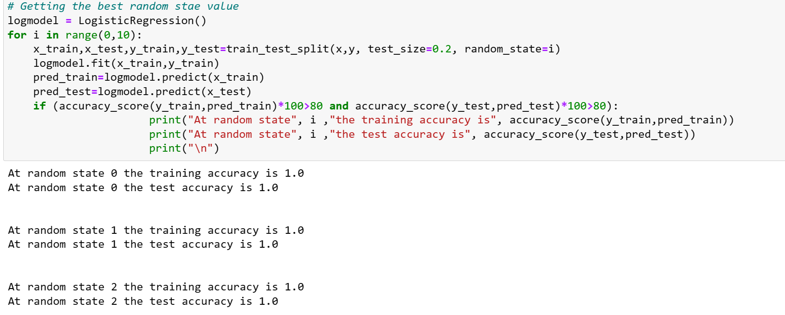
Train Test Split
Spliting/deviding our data into train and test set.
Code:
x_train,x_test,y_train,y_test=train_test_split(x,y, test_size=0.2, random_state=???)

Slide 22
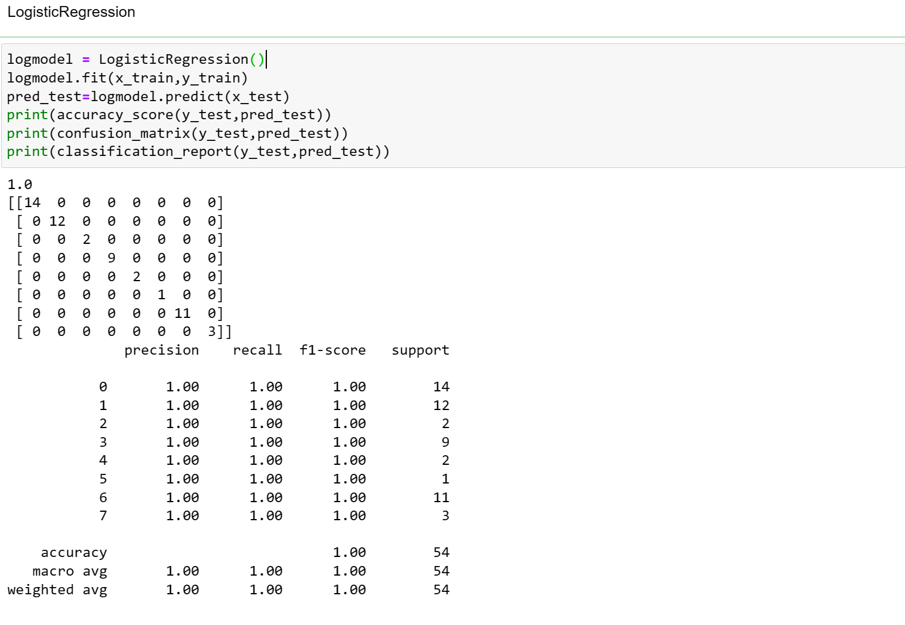
Model Fitting

Slide 23
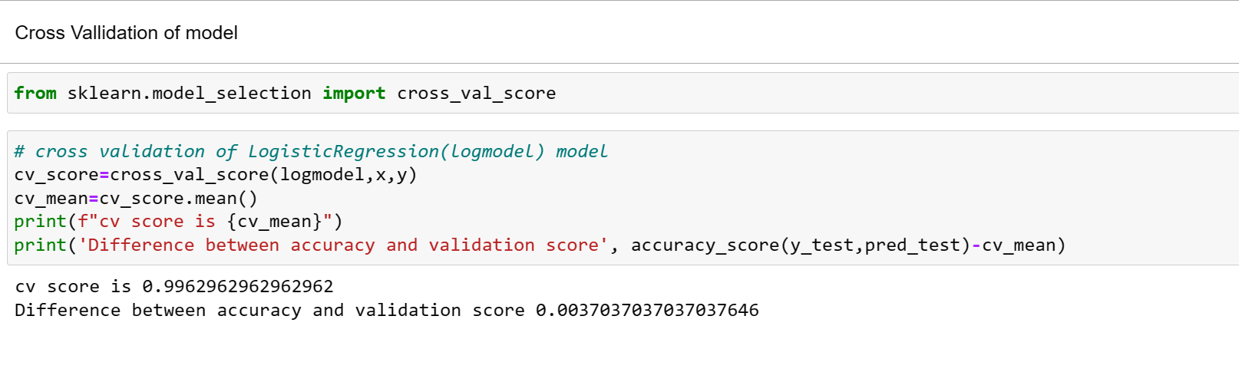
Cross-Validation

Slide 24
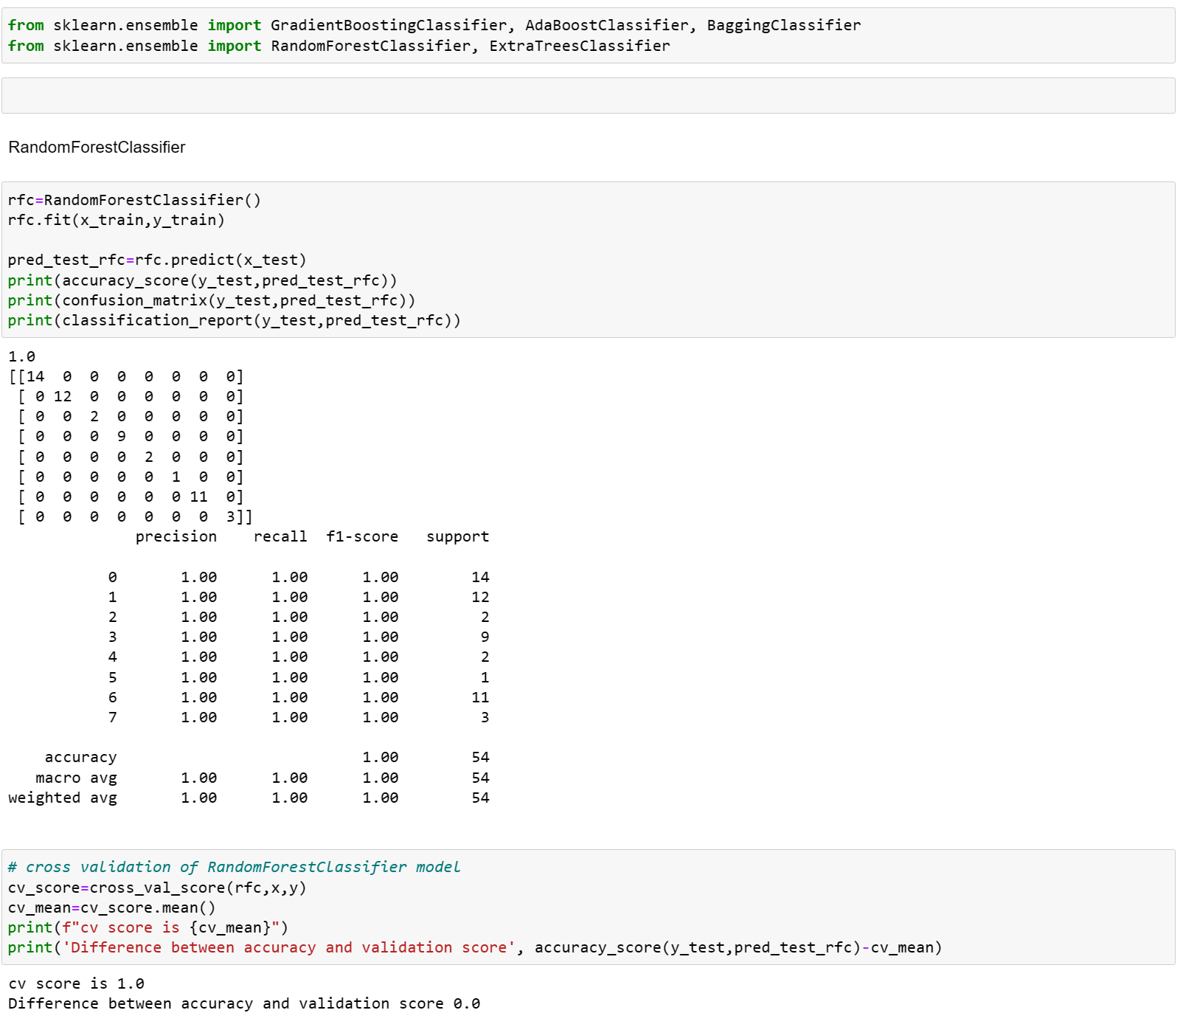
Ensemble Technique
Applying multiple ML algorithm to find the best model

Slide 25
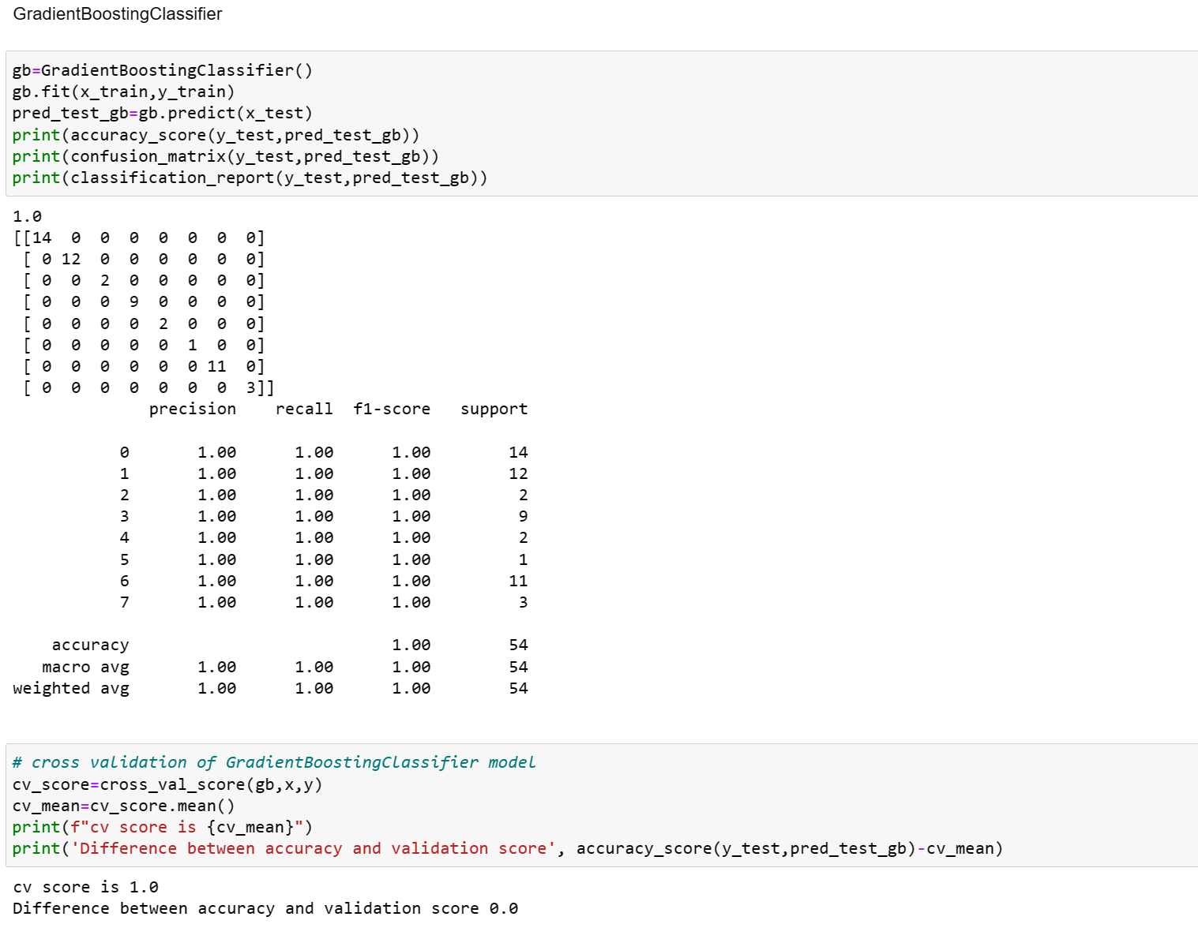

Slide 26
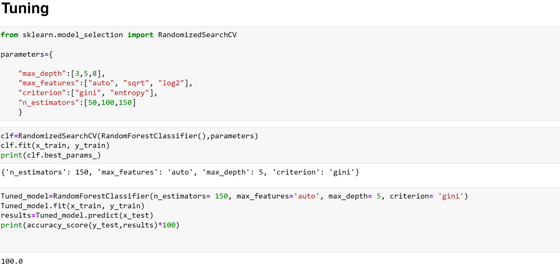
Model Tuning

Slide 27
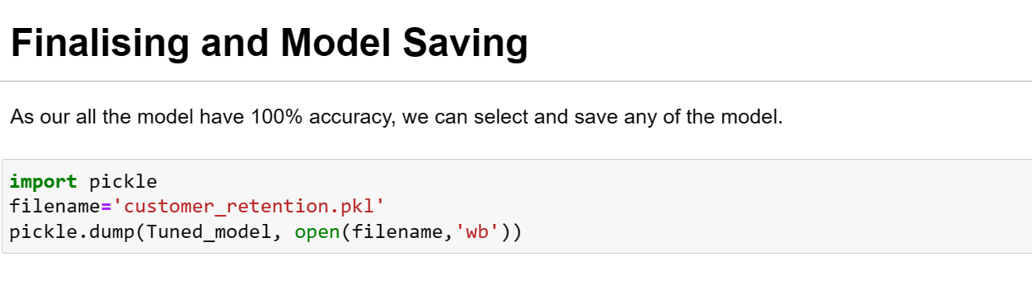
Model Saving

Slide 28
Conclusion
Findings about particiants:
Number of female(67.29%) is twice as of male(32.71%, who participated in the surveay; 90% of the online shoppers are adults aged '31-40 years'(30.11%),'21 -30 years'(29.3%),'41-50 years'(26.02%); 50% of the online shopping done from Delhi NCR; Most of the people have been shoping for more than 4 years, yet most people has shopped only less than 10 times; Mobile internet is the major source for people for online browsing; Most of the people use 'Smartphone' for online shoping. More than 80% people use 'Google Chrome' browse for accessing the shopping website; Most of the online shopping payments are done through 'Credit/Debit Cards'; Most people abandon their 'bag/shoping cart' for better alternative offer;

Slide 29
Feedback and suggestion from people:
'The content of the website must be easy to read and understand'; 'Information on similar product to the one highlighted is important for product comparison'; 'Complete information on listed seller and product being offered is important for purchase decision'; All relevant information on listed products must be stated clearly'; 'Ease of navigation in website'; Loading and processing speed should be high'; 'User friendly Interface of the website'; Convenient Payment methods; Trust that the online retail store will fulfill its part of the transaction at the stipulated time; Empathy (readiness to assist with queries) towards the customers; Being able to guarantee the privacy of the customer; Responsiveness, availability of several communication channels (email, online rep, twitter, phone etc.); Online shopping gives monetary benefit and discounts; Enjoyment is derived from shopping online ; Shopping online is convenient and flexible ; Return and replacement policy of the e-tailer is important for purchase decision ; Gaining access to loyalty programs is a benefit of shopping online ; Displaying quality Information on the website improves satisfaction of customers; User derive satisfaction while shopping on a good quality website or application; Net Benefit derived from shopping online can lead to users satisfaction User satisfaction cannot exist without trust ; Offering a wide variety of listed product in several category; Provision of complete and relevant product information; The Convenience of patronizing the online retailer ; Product should give value for money spent;

Slide 30
E-retailors good attribute score:
1. Amazon and Flipkart scored the best in good attributes of their website 2. Most people agree that 'delivery speed of order' of Amazon and Flipkart is better. 3. Amazon and Flipkart has more variety of product on their site compared to other e-retailers.

Slide 31
E-retailors bad attribute score:
1.Flipkart and Amazon website takes more time to login. 2.Myntra.com website is very slow. 3.Paytm.com and snapdael.com has poor delivery system and take longer time to deliver the product.

Slide 32
All the websites were not equally preferred by participants.
Amazon was the most preferred followed by Flipkart. These two companies are most trusted in the industry and hence, have a huge reliability. Also, the sellers listed on these websites are generally from Tier 1 cities as compared to Snapdeal and PayTM which have more sellers from tier 2 and 3 cities. Also, these websites have the most lenient return policies as compared to others and also the time required to process a return is low for these.

